Slide 1
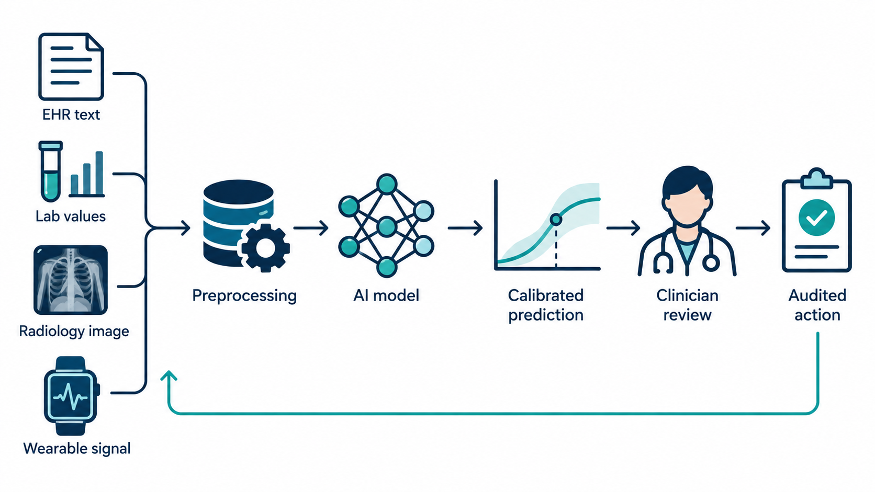
Week 12: Healthcare AI Applications
Healthcare AI
Clinical decision support, medical imaging, RAG, agents, validation, and safe demonstration workflow
Applied Accelerated AI / Advanced GenAI Frameworks
Main idea: healthcare AI is not a chatbot or a model call. It is a safety-critical, auditable decision-support system.
Week 12 — Healthcare AI Applications and Clinical Agent Workflows

Slide 2
Lecture objectives
Overview
Understand healthcare AI as a clinical workflow system, not only as a prediction model.
Distinguish medical imaging, EHR risk prediction, clinical NLP, RAG, and agent-assisted workflows.
Explain why validation, calibration, subgroup evaluation, monitoring, and human oversight are essential.
Understand how standards such as FHIR help exchange structured clinical data.
Prepare students to follow a safe Week 12 demo using a synthetic patient case and guideline-grounded summarization.
Connect healthcare AI to acceleration topics: latency, throughput, privacy boundaries, and deployment monitoring.
Week 12 — Healthcare AI Applications and Clinical Agent Workflows

Slide 3
Lecture roadmap
Overview
Part | Theme
1 | Healthcare AI system view and data modalities
2 | Medical imaging and EHR decision support
3 | Clinical NLP, RAG, and agent-assisted workflows
4 | Privacy, governance, validation, and monitoring
5 | Week 12 demonstration: synthetic case → evidence-grounded clinical note
6 | Evaluation, failure modes, and extensions
The slides are designed so that the live demo becomes understandable after the theory is covered.
Week 12 — Healthcare AI Applications and Clinical Agent Workflows

Slide 4
Healthcare AI as an end-to-end system
System view
Week 12 — Healthcare AI Applications and Clinical Agent Workflows

Slide 5
Why healthcare AI is different
System view
Clinical decisions affect patient safety; a wrong output can cause direct harm.
Clinical data are sensitive, incomplete, biased, and collected for care, not for machine learning.
Model outputs must fit into a real workflow: who sees the output, when, and what action follows?
Prediction alone is insufficient; we need explanation, calibration, auditability, and responsibility.
The correct framing is decision support with human review, not autonomous replacement of clinicians.
Clinical AI output should answer:
• What evidence supports this?
• How uncertain is it?
• Who reviews it?
• What is logged?
Safety principle:
The system should make the clinician more informed, not less responsible.
Week 12 — Healthcare AI Applications and Clinical Agent Workflows

Slide 6
Healthcare data modalities
Data
Modality | Examples | AI tasks
Structured EHR | demographics, medications, diagnoses, vitals, labs | risk prediction, cohort selection, quality measures
Clinical text | notes, discharge summaries, radiology reports | summarization, information extraction, question answering
Medical images | X-ray, CT, MRI, ultrasound, pathology slides | classification, detection, segmentation, report assistance
Signals and devices | ECG, ICU waveforms, wearables | arrhythmia detection, early warning, monitoring
Administrative data | claims, appointments, utilization | resource planning, readmission analysis
Week 12 — Healthcare AI Applications and Clinical Agent Workflows

Slide 7
FHIR: structured exchange for clinical data
Data standards
FHIR stands for Fast Healthcare Interoperability Resources.
It represents healthcare information as modular resources such as Patient, Observation, Condition, MedicationRequest, Encounter, and DiagnosticReport.
FHIR is useful for AI systems because clinical context must be structured, discoverable, and machine-processable.
A clinical agent should usually read from controlled resources rather than scrape arbitrary screens or free text.
In the Week 12 demo, we use a small FHIR-like JSON record to teach the idea without requiring a hospital EHR.
FHIR-like record
{
"resourceType": "Observation",
"code": "oxygen-saturation",
"valueQuantity": {
"value": 91, "unit": "%"
}
}
Source idea: HL7 FHIR is a standard for exchanging healthcare information electronically.
Week 12 — Healthcare AI Applications and Clinical Agent Workflows

Slide 8
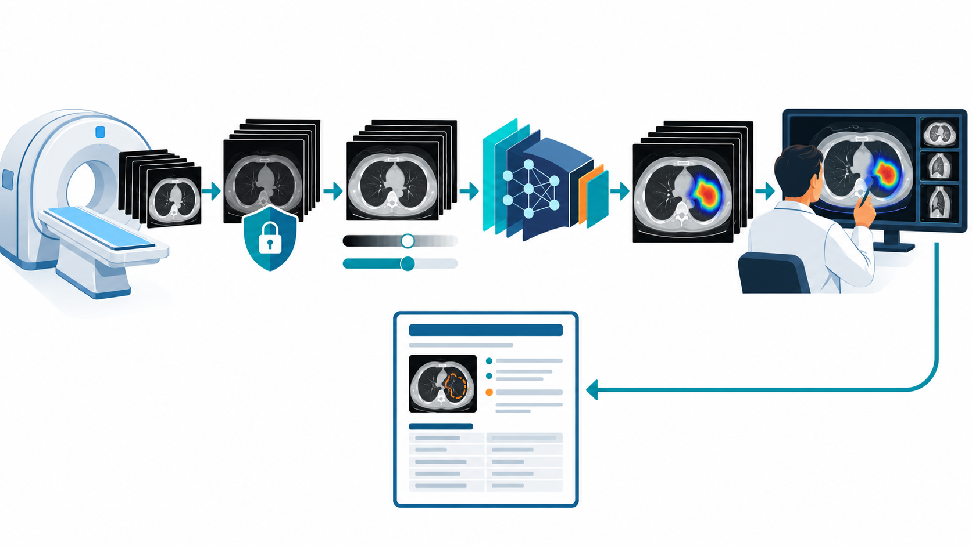
Medical images: from pixels to clinical interpretation
Medical imaging
Medical imaging data are not ordinary photos; they are acquired through clinical devices and usually stored with rich metadata.
AI pipelines must handle modality, orientation, spacing, acquisition protocol, intensity normalization, and privacy-sensitive metadata.
Common tasks include abnormality detection, organ or lesion segmentation, triage, measurement assistance, and report drafting.
A radiologist or specialist remains central because image findings must be interpreted with clinical context.
Week 12 — Healthcare AI Applications and Clinical Agent Workflows

Slide 9
A patient is multimodal, not single-modal
Data
A chest X-ray alone may not tell the full story; the patient history, vitals, labs, comorbidities, and medications matter.
A language model may summarize notes, an imaging model may analyze scans, and a risk model may combine structured variables.
Healthcare AI therefore increasingly combines text, images, tables, and time-series signals.
The challenge is controlled integration: more data can help, but it also increases privacy, bias, and validation complexity.
Example clinical question:
“Does this patient with cough, fever, hypoxia, diabetes, and chest imaging need outpatient treatment or admission review?”
Model answer must be grounded in:
• patient facts
• guidelines
• local protocols
• clinician judgement
Week 12 — Healthcare AI Applications and Clinical Agent Workflows

Slide 10
Part 1: Medical Imaging AI
Section
From acquisition and preprocessing to model output, explanation, and specialist review
DICOM / metadata
Preprocessing
CNN / transformer
Heatmap / mask
Radiologist review
Week 12 — Healthcare AI Applications and Clinical Agent Workflows

Slide 11
Medical imaging AI workflow
Medical imaging
Week 12 — Healthcare AI Applications and Clinical Agent Workflows

Slide 12
Common medical imaging AI tasks
Medical imaging
Task | Output | Example use
Classification | image-level label or probability | pneumonia likely / unlikely
Detection | bounding box around finding | lung nodule, fracture, hemorrhage candidate
Segmentation | pixel/voxel mask | organ volume, tumor boundary, lesion burden
Triage | priority flag | urgent review for suspected stroke or pneumothorax
Report assistance | structured impression draft | summarize measurements and candidate findings
Important: “AI detected a region” is not the same as “final diagnosis.” Image findings require clinical interpretation.
Week 12 — Healthcare AI Applications and Clinical Agent Workflows

Slide 13
Imaging pipeline details
Medical imaging
Acquisition: imaging device and protocol determine resolution, field of view, and artifact patterns.
De-identification: remove or transform patient identifiers before research or demo use.
Preprocessing: resampling, windowing, normalization, cropping, and quality checks.
Inference: model produces probability, heatmap, mask, measurement, or draft text.
Review: specialist checks output, clinical context, uncertainty, and possible failure cases.
Failure examples:
• wrong orientation
• scanner protocol shift
• out-of-distribution anatomy
• artifact mistaken for disease
• heatmap looks plausible but is not causal evidence
Teaching point: the model is only one stage of the imaging system.
Week 12 — Healthcare AI Applications and Clinical Agent Workflows

Slide 14
Explanations in medical imaging: useful but limited
Medical imaging
Heatmaps can help clinicians see which image regions influenced a prediction.
But a heatmap is not proof that the model used a medically valid feature.
Explanations must be checked against clinical knowledge, image quality, and possible confounders.
For high-stakes workflows, explanations are supportive artifacts; validation and human review remain necessary.
Useful question:
“Does the highlighted region correspond to a plausible clinical finding?”
Dangerous question:
“The heatmap looks medical, so the model must be correct.”
Interpretability is not a substitute for external validation.
Week 12 — Healthcare AI Applications and Clinical Agent Workflows

Slide 15
Part 2: EHR Risk Prediction and Clinical Decision Support
Section
From structured data to calibrated predictions, explanations, and clinician action
EHR / FHIR
Risk score
Calibration
Explanation
Decision support
Week 12 — Healthcare AI Applications and Clinical Agent Workflows

Slide 16
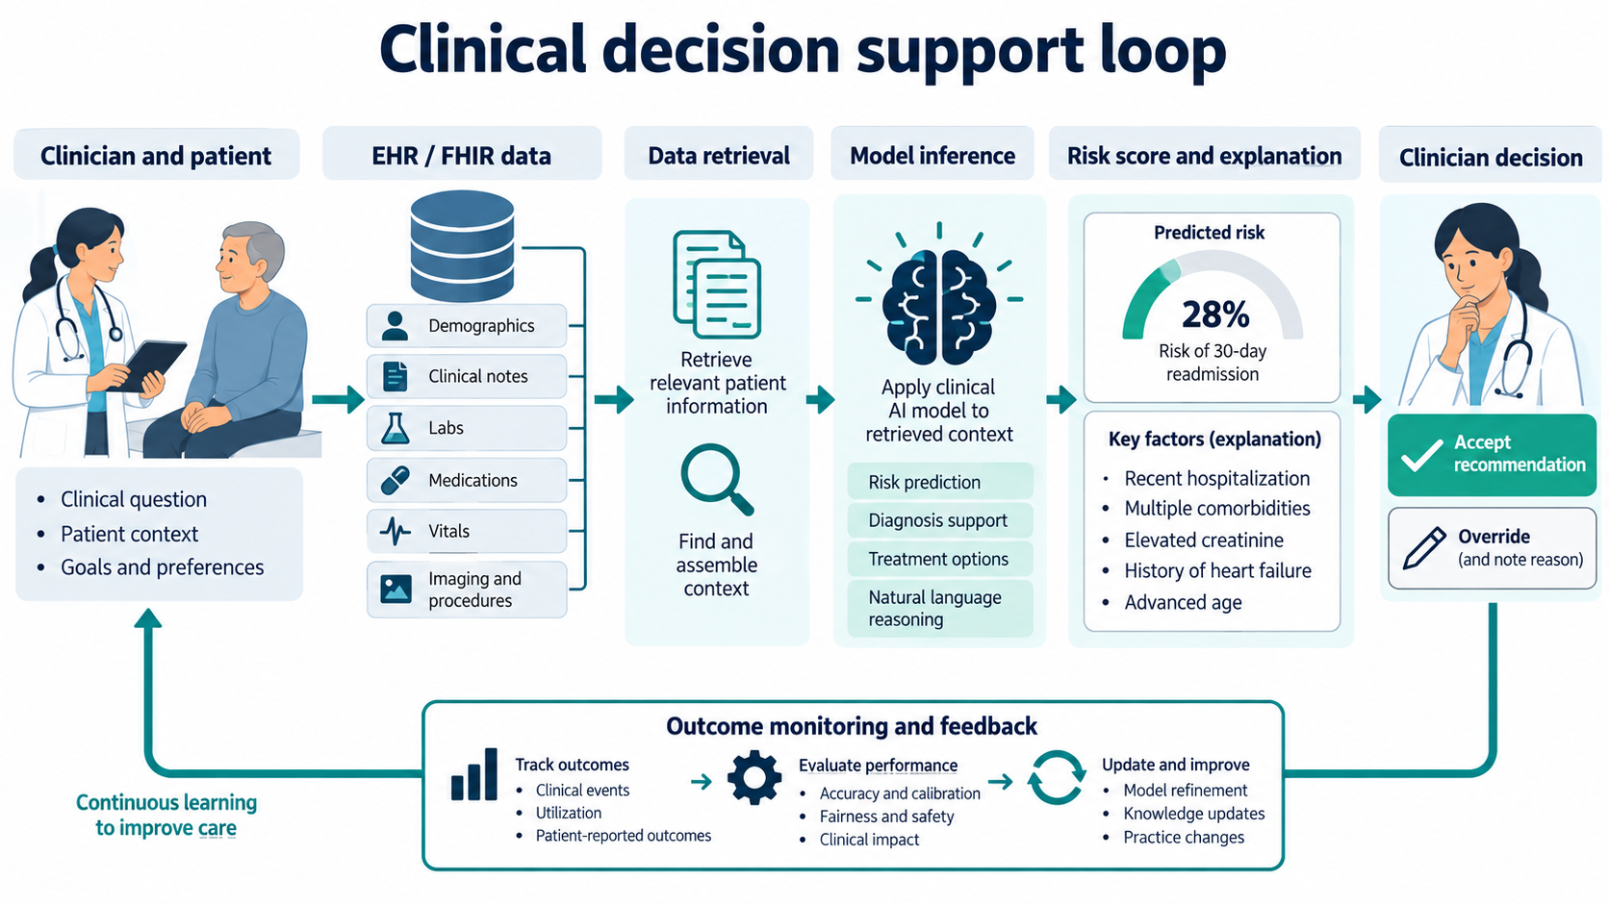
Clinical decision support loop
Decision support
Week 12 — Healthcare AI Applications and Clinical Agent Workflows

Slide 17
EHR risk prediction: what the model usually does
Decision support
The input is a structured patient context: age, diagnoses, medications, labs, vitals, utilization, and sometimes notes.
The output is usually a probability or risk category: readmission risk, deterioration risk, sepsis risk, adverse event risk, or triage priority.
The model does not “know medicine” in the human sense; it learns statistical patterns from historical data.
The result must be calibrated and interpreted within the intended clinical workflow.
Example output:
Predicted 30-day readmission risk = 28%
Key factors: recent hospitalization, elevated creatinine, heart failure history.
Correct question:
“How should this risk estimate change the care plan?”
Incorrect question:
“Can the model decide discharge alone?”
Week 12 — Healthcare AI Applications and Clinical Agent Workflows

Slide 18
Calibration: probability must mean what it says
Evaluation
Accuracy alone is not enough for clinical decision support.
If a model assigns 30% risk to many patients, roughly 30% of those patients should experience the outcome in a well-calibrated setting.
Poor calibration can lead to over-treatment, under-treatment, or alarm fatigue.
Calibration should be checked on the target population and monitored after deployment.
Well calibrated:
Predicted risk ≈ observed outcome frequency
Poorly calibrated:
Scores are ranked correctly but probabilities are misleading.
Clinical meaning:
Calibration affects thresholds, resource allocation, and trust.
Week 12 — Healthcare AI Applications and Clinical Agent Workflows

Slide 19
Explanations for EHR predictions
Decision support
Clinicians need to understand why a patient was flagged, at least at the level of key contributing factors.
Explanations can include feature importance, similar cases, abnormal labs, recent events, or rule-based reasons.
Explanations should be clinically meaningful and should not expose misleading correlations as causal facts.
Best practice: show the model output as a draft signal, allow clinician override, and capture the reason.
Good explanation:
“Risk elevated because of recent admission, rising creatinine, and oxygen requirement.”
Bad explanation:
“Model says high risk.”
Clinician action should remain visible and auditable.
Week 12 — Healthcare AI Applications and Clinical Agent Workflows

Slide 20
Alert fatigue: a systems problem
Decision support
Even a statistically good model can fail operationally if it produces too many alerts.
Clinicians may ignore alerts if they are frequent, poorly timed, or not actionable.
Thresholds should be chosen based on clinical workflow, resource availability, and harm-benefit tradeoffs.
An AI system must be evaluated not only by AUROC, but also by how it changes real decisions and outcomes.
Useful alert:
specific, timely, evidence-linked, and actionable.
Harmful alert:
frequent, vague, late, uncalibrated, or impossible to act on.
Workflow design is part of model performance.
Week 12 — Healthcare AI Applications and Clinical Agent Workflows

Slide 21
Part 3: Clinical NLP, RAG, and Agents
Section
Using language models safely for summarization, guideline assistance, and controlled tool use
Clinical text
Retrieval
Citations
Tool use
Human review
Week 12 — Healthcare AI Applications and Clinical Agent Workflows

Slide 22
Clinical NLP tasks
Clinical NLP
Task | Input | Output
Information extraction | notes, reports | problems, medications, symptoms, dates
Summarization | long chart, discharge notes | brief clinical summary
Report drafting | measurements, findings | draft radiology/pathology/discharge text
Question answering | patient chart + guidelines | answer with sources and uncertainty
Coding assistance | clinical documentation | suggested billing/quality codes for human review
Week 12 — Healthcare AI Applications and Clinical Agent Workflows

Slide 23
Why naive clinical LLM use is unsafe
Clinical NLP
LLMs can produce fluent answers that sound confident even when unsupported.
Clinical facts may be missing, ambiguous, outdated, or contradicted elsewhere in the record.
A model may confuse general medical knowledge with patient-specific evidence.
Privacy-sensitive data should not be sent to unauthorized external services.
Therefore, clinical LLM use should be grounded, constrained, logged, and reviewed.
Common failure modes:
• hallucinated diagnosis
• unsupported treatment suggestion
• missing contraindication
• outdated guideline
• PHI leakage
Safe pattern:
retrieve evidence → draft answer → cite sources → check guardrails → clinician reviews.
Week 12 — Healthcare AI Applications and Clinical Agent Workflows

Slide 24
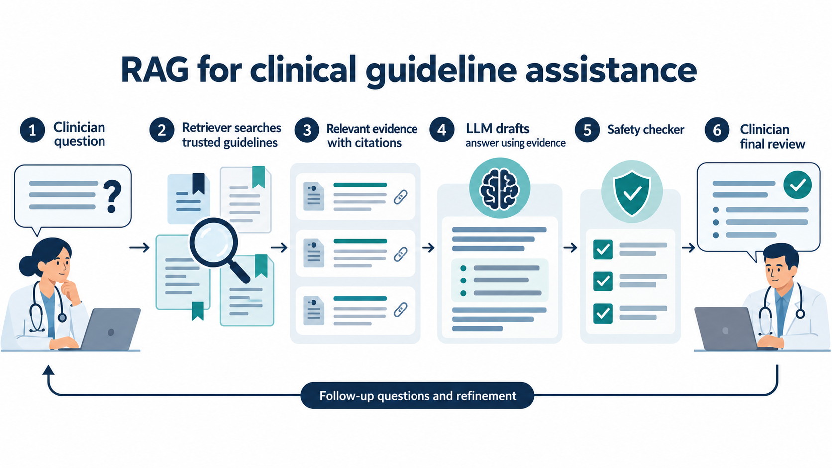
RAG for clinical guideline assistance
RAG
Week 12 — Healthcare AI Applications and Clinical Agent Workflows

Slide 25
Clinical RAG: what changes compared with a plain LLM?
RAG
Retrieval-augmented generation first searches trusted sources such as guidelines, protocols, or institutional documents.
The LLM receives the retrieved passages and should answer using those passages rather than unsupported memory.
The output should include evidence snippets or citations so the clinician can verify the answer.
RAG reduces unsupported answers but does not remove the need for validation, guardrails, and clinician review.
Plain LLM question:
“What antibiotics should I use?”
Risk: answer may be generic or outdated.
RAG question:
“Using these local CAP guideline snippets, draft initial management options and cite the evidence.”
Week 12 — Healthcare AI Applications and Clinical Agent Workflows

Slide 26
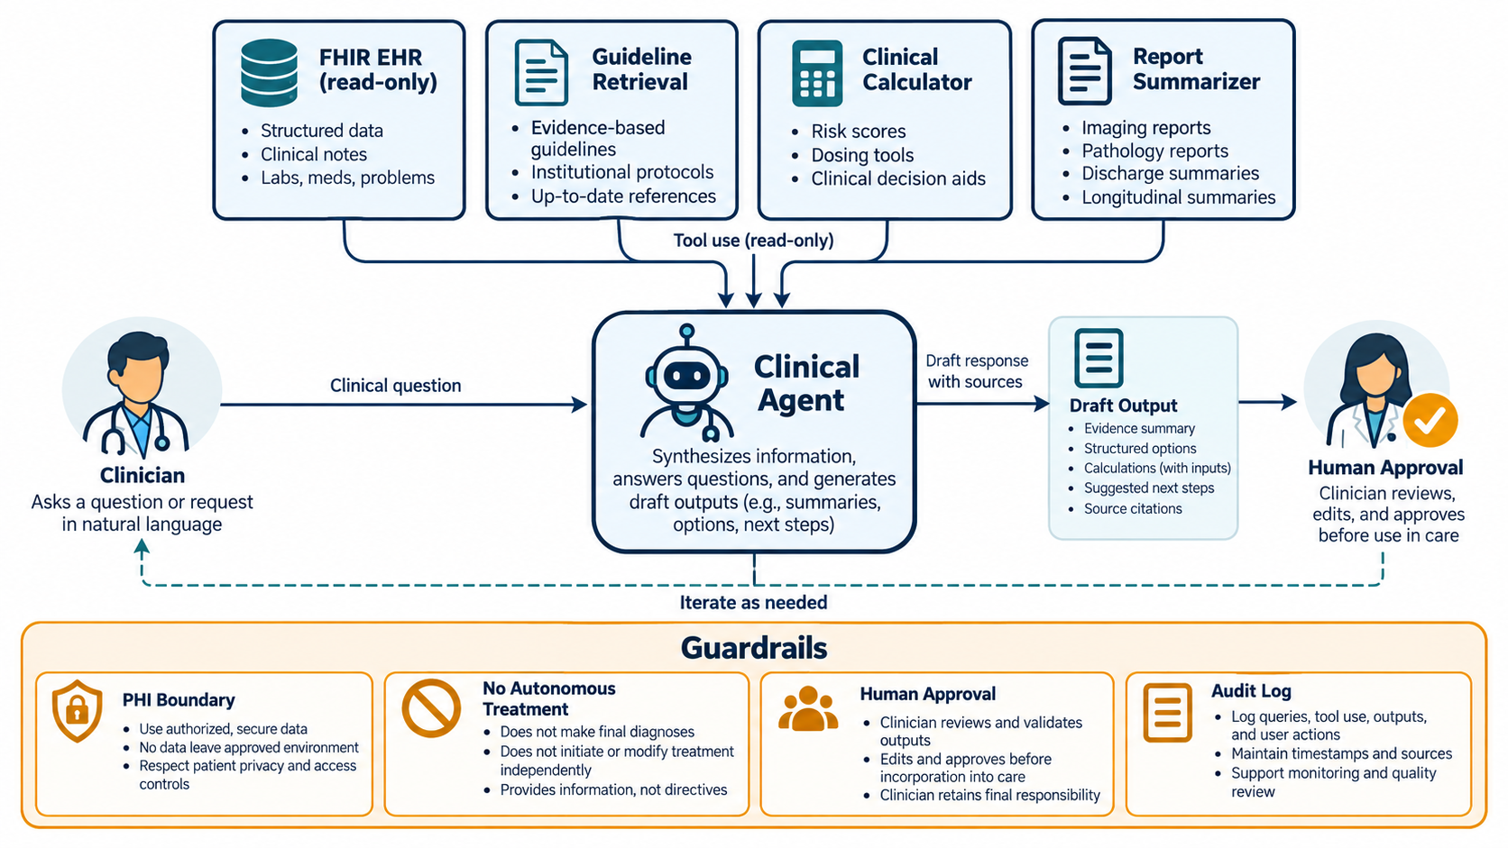
Clinical agents: controlled tool use, not autonomy
Agents
Week 12 — Healthcare AI Applications and Clinical Agent Workflows

Slide 27
What tools can a clinical agent use?
Agents
Tool | Role | Guardrail
FHIR/EHR reader | retrieve patient facts | read-only, authorized data only
Guideline retriever | find evidence and local protocols | source whitelist and citations
Clinical calculator | compute risk scores from explicit inputs | show inputs and formula
Report summarizer | draft concise summaries | no new facts beyond sources
Audit logger | record query, sources, outputs, review | immutable log and versioning
The most important design choice is capability limitation: the agent should not autonomously diagnose, prescribe, or modify the medical record.
Week 12 — Healthcare AI Applications and Clinical Agent Workflows

Slide 28
Guardrails for clinical agents
Agents
Read-only access by default: the agent can retrieve context but cannot silently change the chart.
Source grounding: answers should cite patient facts and guidelines used.
No autonomous treatment: diagnosis, treatment decisions, and orders require clinician action.
Human approval: draft output becomes clinical documentation only after review and edit.
Auditability: log inputs, retrieved sources, tool calls, outputs, reviewer, and final decision.
Week 12 — Healthcare AI Applications and Clinical Agent Workflows

Slide 29
Safe classroom scenario: synthetic pneumonia case
Demo preparation
The demonstration uses a synthetic adult patient case, not real patient data.
The clinical theme is possible community-acquired pneumonia and initial management support.
The system retrieves guideline-like snippets, computes a simple severity score, drafts a summary, and prepares a structured note.
The clinician remains responsible for checking the facts, adapting local treatment, and approving the final note.
The demo is educational; it is not medical advice and should not be used for real patient care.
Why synthetic?
It avoids PHI risk and keeps the lecture focused on system design rather than patient privacy incidents.
Why pneumonia?
It gives a clear example of symptoms, vitals, guideline retrieval, risk scoring, and clinician review.
Week 12 — Healthcare AI Applications and Clinical Agent Workflows

Slide 30
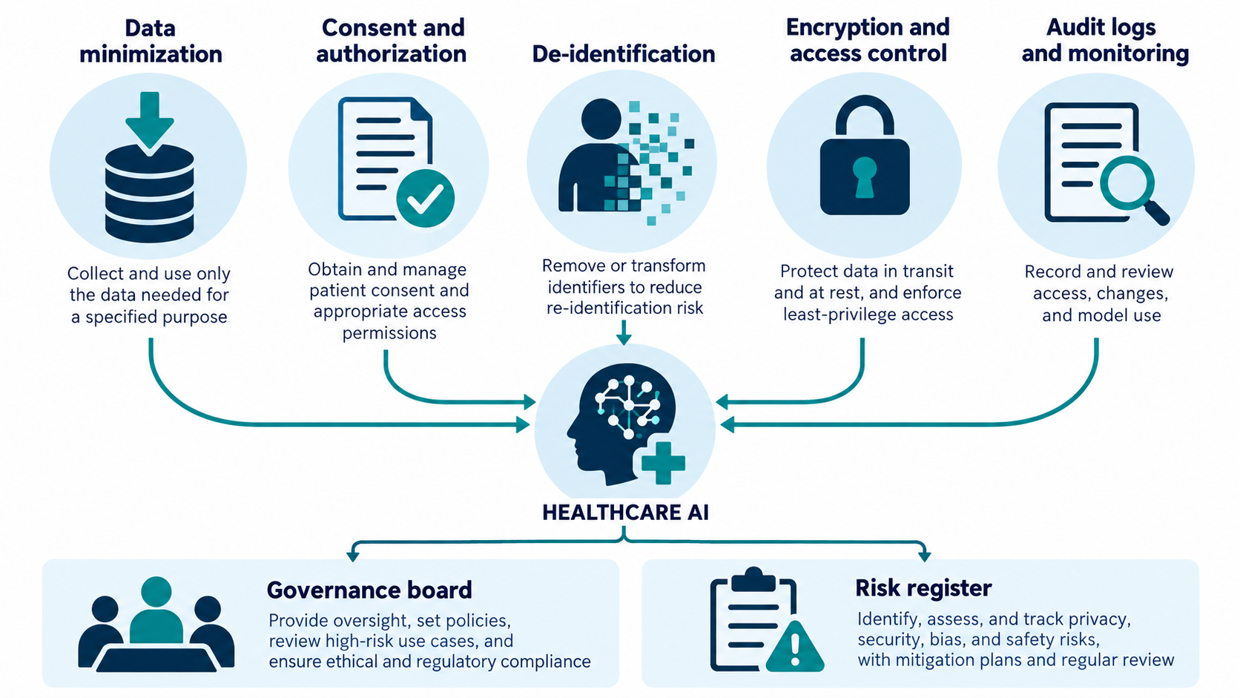
Privacy, security, and governance
Governance
Week 12 — Healthcare AI Applications and Clinical Agent Workflows

Slide 31
Ethical principles for health AI
Governance
Protect autonomy: people and clinicians should not lose meaningful control over health decisions.
Promote safety and well-being: benefits should outweigh risks, and harms must be anticipated.
Ensure transparency and explainability appropriate to the workflow.
Foster responsibility and accountability: someone must own model behavior, monitoring, and incident response.
Ensure inclusiveness and equity by checking subgroup performance and access implications.
Promote responsive and sustainable AI through monitoring, updating, and governance.
Week 12 — Healthcare AI Applications and Clinical Agent Workflows

Slide 32
Protected health information: practical boundaries
Governance
Use the minimum data required for the defined purpose.
Remove or transform identifiers when data are used for research, teaching, or development.
Control access based on role and need-to-know.
Encrypt data at rest and in transit when systems are networked.
Log access, model use, generated outputs, and reviewer decisions.
Never put real patient data into an unauthorized model or tool during a classroom demonstration.
Week 12 — Healthcare AI Applications and Clinical Agent Workflows

Slide 33
Regulatory boundary: intended use matters
Governance
Whether a software function is a medical device depends heavily on intended use and claims.
Software intended for diagnosis, treatment, mitigation, or prevention may enter medical-device regulation depending on jurisdiction and risk.
General education, administrative assistance, and non-clinical wellness tools may fall into different categories.
Therefore, deployment claims must be precise: “draft support for clinician review” is different from “autonomous diagnosis.”
For classroom slides, we discuss engineering principles, not legal clearance advice.
Safe wording for demo:
“Evidence-grounded draft for clinician review.”
Unsafe wording for demo:
“AI diagnoses pneumonia and recommends treatment.”
Intended use is a design, documentation, and governance question.
Week 12 — Healthcare AI Applications and Clinical Agent Workflows

Slide 34
Part 4: Evaluation and Monitoring
Section
How to prove a healthcare AI system is reliable enough for its intended workflow
Internal test
External validation
Calibration
Fairness
Drift monitoring
Week 12 — Healthcare AI Applications and Clinical Agent Workflows

Slide 35
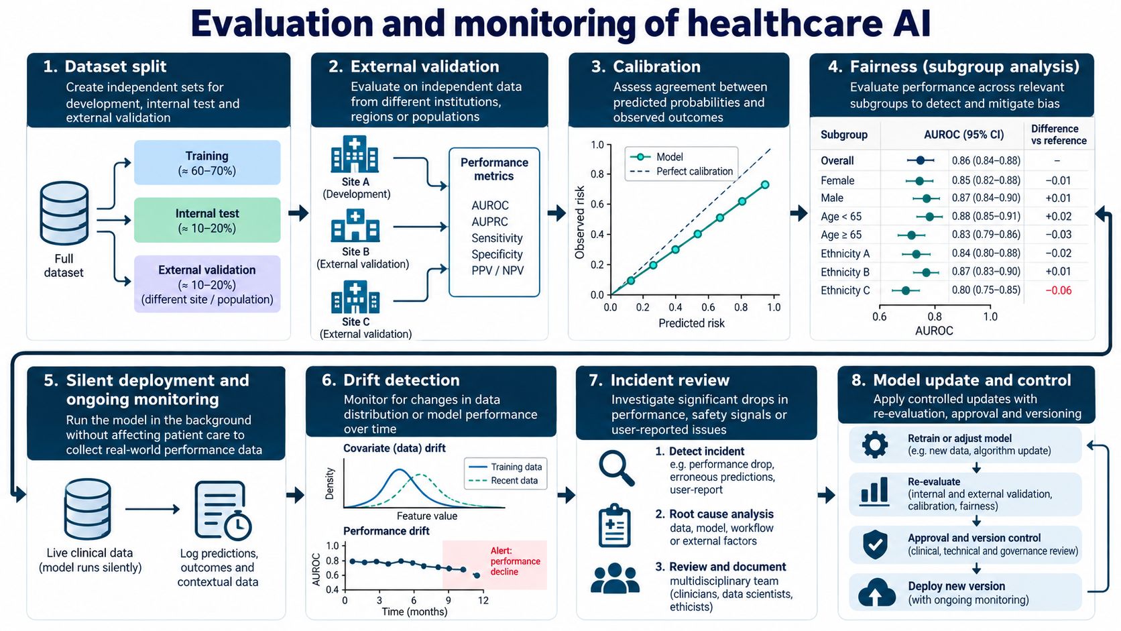
Evaluation and monitoring lifecycle
Evaluation
Week 12 — Healthcare AI Applications and Clinical Agent Workflows

Slide 36
Why external validation is essential
Evaluation
A model can perform well on data from the hospital, scanner, population, or documentation style it was trained on.
Performance may drop when patient mix, equipment, coding practice, disease prevalence, or workflow changes.
External validation tests the model on independent sites or populations before real deployment.
A healthcare AI paper or product should report not only average performance, but also where validation data came from.
Internal test:
“Does the model generalize within this development environment?”
External test:
“Does the model still work in a different institution, scanner, population, or time period?”
Week 12 — Healthcare AI Applications and Clinical Agent Workflows

Slide 37
Metrics must match the clinical task
Evaluation
Task type | Common metrics | Clinical concern
Binary prediction | AUROC, AUPRC, sensitivity, specificity, PPV, NPV | threshold choice and false alerts
Risk scoring | calibration curve, Brier score, decision curve | probability reliability
Segmentation | Dice, IoU, surface distance | boundary accuracy and measurement error
Text summarization | factual consistency, omissions, hallucinations | does the note preserve clinical facts?
Workflow impact | time saved, action rate, outcomes, override rate | does the system help in practice?
Week 12 — Healthcare AI Applications and Clinical Agent Workflows

Slide 38
Subgroup performance and fairness
Evaluation
Average performance can hide poor performance for smaller or underrepresented patient groups.
Healthcare datasets may encode historical inequities, access differences, and measurement bias.
Before deployment, evaluate relevant subgroups: sex, age, site, socioeconomic factors, ethnicity where appropriate and legally/ethically collected, device type, and disease stage.
If subgroup performance is poor, the response may be model revision, workflow adjustment, data collection, or avoiding deployment in that setting.
Fairness question:
“Who benefits, who is missed, and who may be harmed?”
Subgroup analysis is not optional decoration; it is a safety check.
Week 12 — Healthcare AI Applications and Clinical Agent Workflows

Slide 39
Silent deployment before clinical action
Evaluation
In silent deployment, the model runs in the background but does not affect patient care decisions.
This allows teams to measure real-world performance, missing data patterns, latency, and alert volume.
It also helps identify workflow mismatches before clinicians start acting on model output.
Silent deployment is especially useful for high-risk models and new clinical environments.
Silent run collects:
• predictions
• inputs available at prediction time
• outcomes
• latency
• missing data
• drift signals
No patient care should change during this monitoring stage.
Week 12 — Healthcare AI Applications and Clinical Agent Workflows

Slide 40
Drift and model maintenance
Evaluation
Data drift: input distribution changes, for example new device, new documentation practice, or new patient population.
Label drift: the meaning or recording of outcomes changes.
Performance drift: accuracy, calibration, or subgroup performance declines over time.
Maintenance must be controlled: investigate, update, revalidate, approve, version, redeploy, and monitor again.
An uncontrolled model update can be a new risk, not a fix.
Monitoring question:
“Is the model still valid for the patients and workflow it is seeing today?”
Update rule:
No retrained model should silently replace the old one without re-evaluation and approval.
Week 12 — Healthcare AI Applications and Clinical Agent Workflows

Slide 41
Part 5: Week 12 Demonstration
Section
Synthetic patient case → FHIR-like record → guideline retrieval → risk score → structured note → clinician review
Synthetic case
FHIR-like JSON
Guidelines
CURB-65
Audit log
Week 12 — Healthcare AI Applications and Clinical Agent Workflows

Slide 42
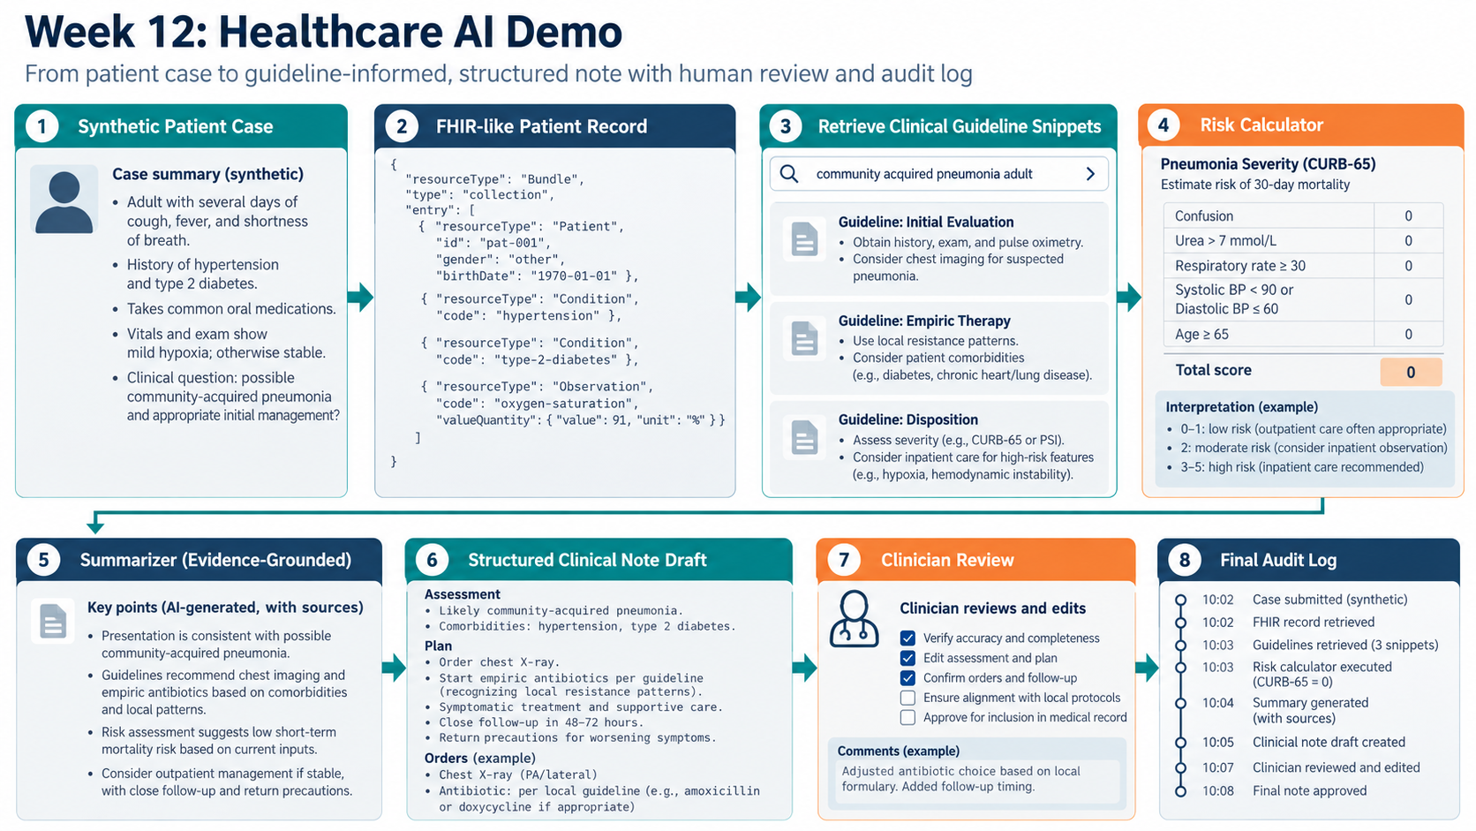
Week 12 demo workflow
Live demo
Week 12 — Healthcare AI Applications and Clinical Agent Workflows

Slide 43
What the demo should teach
Live demo
The demo is not meant to make a real medical recommendation.
It shows how to build a safe pattern for healthcare GenAI: structured data, guideline retrieval, explicit calculator inputs, grounded summarization, human review, and audit logging.
Students should see that the LLM is only one part of the system.
The most important output is not a beautiful paragraph; it is an auditable chain from patient facts and evidence to a clinician-reviewed draft.
Demo slogan:
“Generate drafts, not decisions.”
Every AI-generated statement should be traceable to either:
• a patient fact
• a retrieved guideline snippet
• a calculator output
Week 12 — Healthcare AI Applications and Clinical Agent Workflows

Slide 44
Demo Step 1: synthetic patient case
Live demo
Create a fictional adult patient case with cough, fever, shortness of breath, mild hypoxia, and comorbidities.
Include only synthetic values so that no real patient information is exposed.
Define the clinical question clearly: possible community-acquired pneumonia and initial management support.
Keep the case deliberately simple enough for students to follow, but realistic enough to require multiple data types.
Synthetic case example:
Adult with cough, fever, shortness of breath, oxygen saturation 91%, hypertension, type 2 diabetes, and otherwise stable vitals.
Question:
“What information should be reviewed before deciding outpatient care versus admission review?”
Week 12 — Healthcare AI Applications and Clinical Agent Workflows

Slide 45
Demo Step 2: FHIR-like patient record
Live demo
Translate the case into a structured JSON bundle inspired by FHIR resources.
The purpose is to show machine-readable patient facts, not to implement a full hospital EHR.
Typical fields: Patient, Condition, MedicationStatement, Observation, Encounter, and clinical question.
This is where students see why structured data is easier to audit than a free-form prompt.
Illustrative fragment
{
"resourceType": "Bundle",
"entry": [
{"resourceType":"Patient"},
{"resourceType":"Condition",
"code":"type-2-diabetes"},
{"resourceType":"Observation",
"code":"oxygen-saturation",
"value":91, "unit":"%"}
]
}
Week 12 — Healthcare AI Applications and Clinical Agent Workflows

Slide 46
Demo Step 3: retrieve guideline snippets
Live demo
The system searches a small trusted guideline collection prepared for the class.
Retrieval should return short snippets relevant to initial evaluation, empiric therapy, severity assessment, and follow-up.
The LLM should not answer from memory alone; it should use these snippets as its grounding context.
Students should inspect which snippets were retrieved before reading the generated summary.
Good retrieved evidence:
• initial evaluation
• chest imaging consideration
• empiric therapy principles
• severity assessment
• return precautions
Bad retrieval:
irrelevant disease, pediatric guideline for adult case, outdated protocol, missing source.
Week 12 — Healthcare AI Applications and Clinical Agent Workflows

Slide 47
Demo Step 4: explicit risk calculator
Live demo
Use an explicit calculator step rather than asking the LLM to invent a risk category.
The calculator should show its inputs so students can verify them.
For pneumonia, the demo can illustrate a simple severity score such as CURB-65 conceptually.
The calculator output should be treated as one evidence component, not as the whole clinical answer.
Calculator transparency:
Confusion?
Urea?
Respiratory rate?
Blood pressure?
Age >= 65?
Teaching point:
If the system cannot show inputs, the risk score should not be trusted.
Week 12 — Healthcare AI Applications and Clinical Agent Workflows

Slide 48
Demo Step 5: evidence-grounded summary
Live demo
The summarizer receives patient facts, retrieved guideline snippets, and calculator output.
The summary should explicitly separate patient-specific facts from guideline-based suggestions.
It should avoid unsupported treatment certainty and should mention need for clinician review.
Every important claim should be traceable to either patient facts or retrieved evidence.
Good wording:
“Presentation is consistent with possible community-acquired pneumonia; guideline snippets support chest imaging and empiric therapy consideration, with local protocol review.”
Bad wording:
“Patient definitely has pneumonia; start antibiotic X.”
Week 12 — Healthcare AI Applications and Clinical Agent Workflows

Slide 49
Demo Step 6: structured note draft
Live demo
The system produces a structured draft, for example Assessment and Plan.
The draft should mark itself as AI-generated and requiring clinician review.
It should include placeholders where local protocols or missing data must be checked.
The clinician should edit, approve, or reject the draft before it becomes part of any real record.
Draft note structure
Assessment:
- Possible community-acquired pneumonia
- Mild hypoxia; comorbid diabetes
Plan draft:
- confirm vitals and exam
- chest X-ray if clinically indicated
- consider empiric therapy per local protocol
- close follow-up / return precautions
Status: requires clinician review
Week 12 — Healthcare AI Applications and Clinical Agent Workflows

Slide 50
Demo Step 7: clinician review and audit log
Live demo
Clinical review is the moment where responsibility stays with the human professional.
The clinician checks factual accuracy, guideline relevance, missing data, and local protocol alignment.
The audit log records key events: case submitted, records retrieved, guidelines retrieved, calculator executed, summary generated, note drafted, clinician edited, final version approved.
An audit trail makes the workflow inspectable after the fact.
Audit log should record:
• timestamp
• user
• tool calls
• sources
• model output
• edits
• approval status
No silent AI output should become clinical documentation.
Week 12 — Healthcare AI Applications and Clinical Agent Workflows

Slide 51
Suggested live demo sequence
Live demo
Step | What to show
1 | Open the synthetic case and explain that no real PHI is used.
2 | Show FHIR-like JSON and identify Patient, Condition, Observation fields.
3 | Run guideline retrieval and inspect retrieved snippets.
4 | Run calculator and verify each input.
5 | Generate grounded summary and check sources.
6 | Generate structured note draft and identify review-required sections.
7 | Show clinician review checklist and audit log.
8 | Discuss latency, privacy, and deployment limitations.
Week 12 — Healthcare AI Applications and Clinical Agent Workflows

Slide 52
Demo commands: simple classroom flow
Live demo
Use the prepared notebook or scripts with synthetic data only.
Run the pipeline step by step rather than hiding everything behind one button.
After each step, pause and ask students what evidence was produced and what still needs human review.
Keep a pre-generated output folder as backup in case the live model call is slow.
Example command sequence
python prepare_case.py --case synthetic_pneumonia.json
python retrieve_guidelines.py --case outputs/case_fhir.json
python run_calculator.py --case outputs/case_fhir.json
python draft_summary.py --case outputs/case_fhir.json
python draft_note.py --summary outputs/summary.json
python review_audit.py --note outputs/note_draft.json
If using a notebook, each command becomes one visible cell.
Week 12 — Healthcare AI Applications and Clinical Agent Workflows

Slide 53
Demo outputs students should inspect
Live demo
Output | Purpose
case_fhir.json | structured synthetic patient record
retrieved_guidelines.json | evidence snippets used for grounding
risk_score.json | calculator inputs and score
summary_with_sources.txt | AI draft summary with evidence basis
clinical_note_draft.txt | structured note draft requiring review
audit_log.jsonl | timestamped record of tool calls and approvals
The best classroom discussion comes from opening the files, not only showing the final paragraph.
Week 12 — Healthcare AI Applications and Clinical Agent Workflows

Slide 54
Troubleshooting during the demo
Live demo
Problem | Immediate fix
LLM is slow | Use deterministic or cached output; continue explaining the pipeline.
Retriever returns irrelevant snippets | Reduce corpus size, improve query, or manually inspect snippet IDs.
Summary adds unsupported claim | Show guardrail failure and remove the claim during review.
Calculator input missing | Mark as unknown; do not infer silently.
Network unavailable | Use local cached guideline snippets and generated outputs.
Students focus only on the LLM | Bring attention back to structured data, retrieval, calculator, review, and audit log.
Week 12 — Healthcare AI Applications and Clinical Agent Workflows

Slide 55
Class activity: evaluate the draft output
Class discussion
Give students the generated summary and the retrieved snippets.
Ask them to mark every sentence as one of three categories: supported by patient facts, supported by guideline snippet, or unsupported.
Ask them to identify any missing information that would matter clinically.
Ask whether the wording makes the AI sound too authoritative.
Finally, ask what should be written in the audit log before clinician approval.
Week 12 — Healthcare AI Applications and Clinical Agent Workflows

Slide 56
Failure modes to explicitly teach
Failure analysis
Failure mode | Why it matters
Missing patient fact | summary may appear complete while omitting key contraindication
Wrong retrieved guideline | answer may be evidence-shaped but clinically irrelevant
Unsupported treatment claim | model oversteps from support to decision-making
Bad calculator input | transparent score becomes misleading
Poor calibration of risk model | probability no longer supports thresholds
No audit trail | system cannot be investigated after an incident
Week 12 — Healthcare AI Applications and Clinical Agent Workflows

Slide 57
Extensions after Week 12
Extensions
Add a second case: heart failure follow-up, diabetes medication review, or discharge summary generation.
Compare plain LLM answer versus RAG-grounded answer with citations.
Add a small local embedding retriever for guideline snippets.
Add an external validation exercise using synthetic cohorts.
Profile latency: retrieval time, model generation time, and total workflow time.
Discuss deployment architectures: hospital network, private cloud, on-device inference, and audit storage.
Week 12 — Healthcare AI Applications and Clinical Agent Workflows

Slide 58
Final synthesis
Summary
Healthcare AI workflow:
patient context → structured data → trusted retrieval → model or calculator → evidence-linked draft → clinician review → audit log → monitoring
Detection, prediction, or generation alone is not enough for healthcare deployment.
The system must make uncertainty, evidence, reviewer responsibility, and downstream action visible.
The same concepts from accelerated AI still matter: latency, throughput, memory, privacy, monitoring, and versioning.
The safest teaching message is: healthcare AI should support clinicians with grounded, reviewable, and auditable outputs.
Week 12 — Healthcare AI Applications and Clinical Agent Workflows

Slide 59
References and source basis
References
World Health Organization. Ethics and governance of artificial intelligence for health. 2021.
World Health Organization. Ethics and governance of artificial intelligence for health: guidance on large multi-modal models. 2025..
HL7. FHIR overview: standard for exchanging healthcare information electronically.
FDA. AI-enabled device software functions and predetermined change control plan guidance; intended-use and device-software considerations.
NICE/BTS-style pneumonia severity teaching example: CURB-65/CRB-65 as clinical severity tools, used only as an illustrative calculator in this demo.
Course Week 12 demo: synthetic patient case, FHIR-like JSON, retrieval, risk calculator, structured note draft, clinician review, and audit log.
Figures in this deck are AI-generated academic teaching diagrams prepared specifically for this lecture.
Week 12 — Healthcare AI Applications and Clinical Agent Workflows

Slide 60
Thank you
Week 12
Healthcare AI Applications and Clinical Agent Workflows
Ready for the Week 12 demonstration
Week 12 — Healthcare AI Applications and Clinical Agent Workflows

